Slide 1

Academic Session 2025-26
Even Semester Jan-May 2025
UNIVERSITY INSTITUTE OF ENGINEERING
AIT-CSE (AIML)
CS221: B.E. CSE (AIML)
5th Semester
ADVANCED MACHINE LEARNING & MATHEMATICAL MODELLING
(23CSH-382)
Unit No. 1 Chapter No. 1 Lecture No. 12 & 13
Topic: Discrete Probability Distributions & Continuous Probability Distributions
Mr. Siddharth Kumar (E12853) Assistant Professor

Slide 2
COURSE OBJECTIVES
1
The course aims to:
To develop a strong mathematical foundation for regression-based predictive modelling using calculus, matrix algebra, and probability theory.
To provide an in-depth understanding of supervised classification algorithms including KNN, Support Vector Machines, and ensemble-based boosting approaches.
To equip learners to implement clustering and probabilistic reasoning models such as Spectral Clustering, Markov Chains, Bayesian Networks, and HMMs.
To cultivate the ability to design neural networks, implement multilayer perceptron, and optimize training using backpropagation and regularization strategies.
To expose students to advanced deep learning frameworks, feature abstraction hierarchies, and performance enhancement through hyper-parameter tuning & dropout.

Slide 3

COURSE OUTCOMES
2
On completion of this course, the students shall be able to:
CO1 | Recall the foundational concepts, terminology, and mathematical principles underlying regression, classification and clustering approaches.
CO2 | Illustrate the working mechanisms, characteristics, and theoretical concept of regression, clustering and classification techniques in machine learning.
CO3 | Apply appropriate regression, clustering and classification algorithms to solve real-world machine learning tasks while addressing performance constraints.
CO4 | Analyze and evaluate machine learning models using performance parameters to identify the best-suited techniques for specific applications regression, clustering and classification algorithms.
CO5 | Design and implement optimized machine learning solutions by integrating regression, clustering and classification models to solve complex predictive and decision-making problems.

Slide 4
Unit-I Syllabus
3
Unit-1 | Regression | Contact Hours: 15
Regression | Linear and Polynomial Regression, Maxima and Minima of Function of One Variable, Rank, Eigen Values and Eigen Vectors, Positive & Negative Definite/Semi-definite Matrices
Error Estimation | Maxima and Minima of Function of Several Variables, Convexity of Errors Function, Building Simple Linear Regression Model by Solving Normal Equations, Gradient Descent, Stochastic & Mini-batch Gradient Descent Algorithm
Probability Theory | Discrete Probability Distributions, Continuous Probability Distributions, Normal Distribution and t-Distributions, RSE, R²

Slide 5
SUGGESTIVE READINGS
4
Text Books / Reference Books:
TEXT BOOKS
T1: Massaron, L., & Boschetti, A. (2016). Regression analysis with Python. Packt Publishing Ltd.
T2: Jajuga, K., Sokolowski, A., & Bock, H. H. (Eds.). (2012). Classification, clustering, and data analysis: recent advances and applications.
T3: Bishop, C. M., & Bishop, H. (2023). Deep learning: Foundations and concepts. Springer Nature.
REFERENCE BOOKS
R1: Matloff, N. (2017). Statistical regression and classification: from linear models to machine learning. Chapman and Hall/CRC.
R2: Jajuga, K., Sokolowski, A., & Bock, H. H. (Eds.). (2012). Classification, clustering, and data analysis: recent advances and applications.
R3: Vishnoi, V. K., Chauhan, N. R., & Kumar, K. (2024). An introduction to deep learning. Xoffencer publication.

Slide 6
Table of Contents
5
Probability Distributions
Discrete Probability Distributions
Types of Discrete Probability Distributions
Continuous Probability Distributions
Types of Continuous Probability Distributions

Slide 7
Probability Distributions
6
A probability distribution is a mathematical function that assigns the probabilities of different outcomes to the possible values of a random variable.
It provides a way of modeling the likelihood of each outcome in a random experiment.
While a Frequency Distribution shows how often outcomes occur in a sample or dataset, a probability distribution assigns probabilities to outcomes abstractly, theoretically, regardless of any specific dataset.
These probabilities represent the likelihood of each outcome occurring.
Properties of a probability distribution include:
The probability of each outcome is greater than or equal to zero.
The sum of the probabilities of all possible outcomes equals 1.

Slide 8
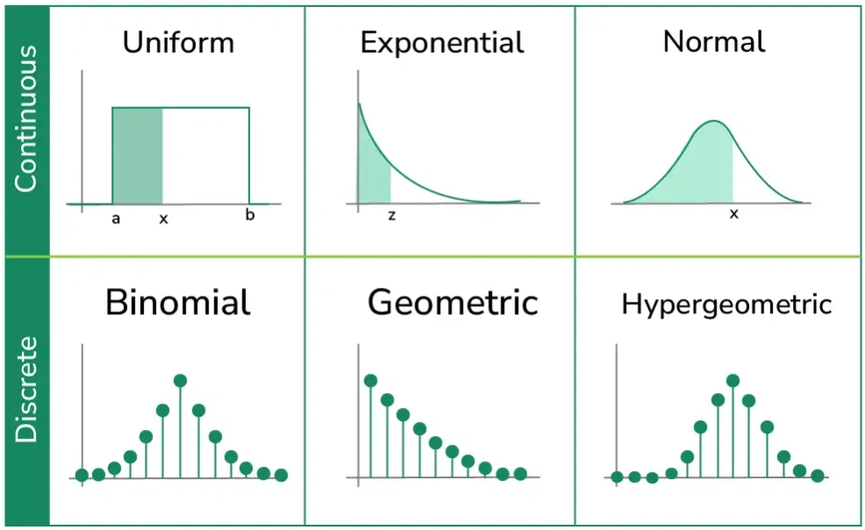
Probability Distributions
7
Common types of probability distributions include:
Figure-1: Types of probability distributions

Slide 9
Probability Distributions
8
Probability Distribution of a Random Variable
Now the question comes, how to describe the behavior of a random variable?
Suppose that our Random Variable only takes finite values, like x₁, x₂, x₃,..., and x_{n}. i.e., the range of X is the set of n values is {x₁, x₂, x₃,..., and x_{n}}.
The behavior of X is completely described by giving probabilities for all the values of the random variable X.
Event | Probability
x₁ | P(X = x₁)
x₂ | P(X = x₂)
x₃ | P(X = x₃)
The Probability Function of a discrete random variable X is the function p(x) satisfying.
P(x) = P(X = x)

Slide 10
Probability Distributions
9
A probability distribution is a function that assigns probabilities to all possible outcomes of a random variable, showing the likelihood of each event.
It is used in statistics for modeling random phenomena and can be either discrete, which applies to outcomes that can be counted (like the number of heads in coin flips), or continuous, which applies to outcomes that can take any value within a range (like a person's height).
Types of Probability Distributions
There are two types of Probability Distributions:
Discrete Probability Distributions for Discrete Variables
Continuous Probability Distribution for Continuous Variables

Slide 11
Discrete Probability Distributions
10
Discrete Probability Functions applies to discrete random variables, which take countable values (e.g., 0, 1, 2, …).
These distributions assign probabilities to individual outcomes. It includes distributions such as Bernoulli, Binomial, and Poisson, which are used to model outcomes that can be counted, as explained below:
A discrete probability distribution describes the likelihood of each possible outcome for a discrete random variable. A discrete random variable is a variable that can take on a countable number of distinct values, typically whole numbers.
In simpler terms, it’s a way to assign a probability to each value that the variable can have, showing how likely each outcome is.

Slide 12
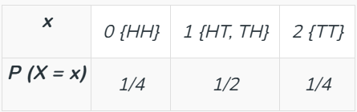
Discrete Probability Distributions
11
The common examples of discrete probability distributions include Bernoulli, Binomial, Poisson, and Geometric distributions.
Conditions for the discrete probability distribution are:
The probability of a discrete random variable lies between 0 and 1: 0 ≤ P (X = x) ≤ 1
Sum of Probabilities is always equal to 1: ∑ P (X =x) = 1
Example: Let two coins be tossed; then the probability of getting a tail is an example of a discrete probability distribution. The sample space for the given event is {HH, HT, TH, TT}, and let X be the number of tails.
Then, the discrete probability distribution table is given by:

Slide 13
Discrete Probability Distributions
12
Discrete Probability Distribution Formulas
The different formulas for the discrete probability distribution, like the probability mass function, the cumulative distribution function, and the mean and variance, are given below.
PMF of Discrete Probability Distribution: Probability Mass Function (PMF) of a discrete random variable X is the value completely equal to x. The PMF i.e., probability mass function of a discrete probability distribution is given by:
f(x) = P (X = x)
Example: A discrete random variable X as the number of heads obtained when tossing two fair coins.

Slide 14
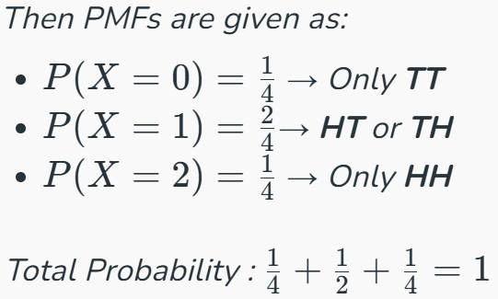
Discrete Probability Distributions
13
A discrete random variable X as the number of heads obtained when tossing two fair coins.
Possible Outcomes:
HH → 2 heads
HT, TH → 1 head
TT → 0 heads
Then PMFs are given as:
Properties of PMF:
The sum of all probabilities must always equal 1. i.e. ∑P(X=x)=1
P(X = x) ≥ 0

Slide 15
Discrete Probability Distributions
14
Cumulative Distribution Function (CDF) of Discrete Probability Distribution
CDF of a discrete random variable X is less than or equal to value x. The CDF i.e., cumulative distribution function of discrete probability distribution is given by:
f(x) = P (X ≤ x)
Example: A random variable X as the outcome of rolling a fair 4-sided die. To find P(1<X≤3):
P(1<X≤3) = F(3)−F(1) = 0.7−0.2 = 0.5
X | PMF | CDF
1 | 0.2 | 0.2
2 | 0.3 | 0.2+0.3 = 0.5
3 | 0.2 | 0.5+0.2 = 0.7
4 | 0.3 | 0.7+0.3 = 1

Slide 16
Discrete Probability Distributions
15
How to Find Discrete Probability Function
Steps to find the discrete probability function are given below:
Step 1: First determine the sample space of the given event.
Step 2: Define random variable X as the event for which the probability to be found.
Step 3: Consider the possible values of x and find the probabilities for each value.
Step 4: Write all the values of x and their respective probabilities in tabular form to get the discrete probability distribution.

Slide 17

Discrete Probability Distributions
16
Types of Discrete Probability Distribution
The different types of discrete probability distribution are listed below.
Bernoulli Distribution
Binomial Distribution
Poisson Distribution
Geometric Distribution
Bernoulli Distribution: A discrete probability distribution with the probability of success p if the value of random variable is 1 and the probability of failure 1-p if the value of random variable is zero is called the Bernoulli distribution. The probability mass function of the Bernoulli distribution is given by:

Slide 18


Discrete Probability Distributions
17
Binomial Distribution: A discrete probability distribution that includes the number of trials n, probability of success and probability of failure is called as Binomial distribution. The probability mass function of the Binomial distribution is given by:
Poisson Distribution: A discrete probability distribution that gives the number of events occurred at a specific time period with the help of its mean is called as the Poisson distribution. The probability mass function of Poisson distribution is given by:

Slide 19

Discrete Probability Distributions
18
Geometric Distribution: A discrete probability distribution that includes the successive failure probability until the success probability is encountered is called as Geometric distribution. The probability mass function of the geometric distribution is given by:
Application of Discrete Probability Distribution in Computer Science
1. Randomized Algorithms
Algorithms that use random numbers to make decisions during execution.
Discrete Distribution is used in Uniform distribution for selecting random pivots.
Use: Quicksort, randomly selecting a pivot (uniformly from array indices) helps avoid worst-case O(n²) scenarios.

Slide 20
Discrete Probability Distributions
19
2. Packet Loss Modeling (Bernoulli/Binomial)
Modeling whether individual network packets are successfully transmitted.
Discrete Distribution application is in Bernoulli for single packet loss (success/failure) and Binomial for total lost packets in n transmissions.
3. Naive Bayes Classifiers (discrete feature modeling)
Probabilistic classifier based on Bayes' theorem with feature independence assumption.
Discrete Distribution is used to find word counts in text (Multinomial distribution) and Bernoulli for binary features.

Slide 21
Continuous Probability Distributions
20
In machine learning, we often face uncertainty in our data. Continuous probability distributions help us understand this uncertainty by showing how likely different values are to occur.
Whether predicting prices or classifying images, these distributions let us make smarter, more reliable predictions by accounting for the randomness in the real world.
Continuous probability distributions is a probability distribution is a mathematical function that describes the likelihood of different outcomes for a random variable.
It is a probability distributions that apply to continuous random variables.
It describes events that can take on any value within a specific range, like the height of a person or the amount of time it takes to complete a task.

Slide 22
Continuous Probability Distributions
21
In continuous probability distributions, two key functions describe the likelihood of a variable taking on specific values:
1. Probability Density Function (PDF): The probability density function gives the probability density at a specific point or interval for a continuous random variable. It indicates how likely the variable is to fall within a small interval around a particular value.
The height of the PDF curve at any point represents the probability density at that value.
Higher density implies a higher probability of the variable taking on values around that point.

Slide 23
Continuous Probability Distributions
22
2. Cumulative Distribution Function (CDF): The Cumulative Distribution Function gives the probability that a random variable is less than or equal to a specific value.
It provides a cumulative view of the probability distribution, starting at 0 and increasing to 1 as the value of the random variable increases.
The CDF starts at 0 for the smallest possible value of the random variable (since there is no probability below this value) and approaches 1 as the value approaches infinity (since the probability of the variable being less than or equal to infinity is 1).
Note: CDF is the integral of the PDF and the PDF is the derivative of the CDF.

Slide 24
Continuous Probability Distributions
23
Importance of Continuous Probability Distribution
Modeling Uncertainty: They help represent uncertainty in predictions, allowing probabilistic outputs instead of fixed values.
Gaussian Distribution: Widely used in models like regression and Bayesian networks for error modeling and assumption of normality.
Maximum Likelihood Estimation (MLE): Lots of algorithms rely on continuous distributions to estimate model parameters that maximize the likelihood of observed data.
Bayesian Inference: Continuous distributions are essential in Bayesian models to update beliefs about parameters based on new data.

Slide 25

Continuous Probability Distributions
24
Generative Models: Models like Gaussian Mixture Models and Variational Autoencoders use continuous distributions to learn and generate data.
Types of Continuous Probability Distributions
1. Normal Distribution (Bell Curve) or Gaussian Distribution: The Gaussian Distribution is a bell-shaped, symmetrical basic continuous probability distribution. Two factors define it:
the standard deviation (σ), which indicates the distribution's spread or dispersion,
the mean (μ), which establishes the distribution.
For a random variable x, it is expressed as,

Slide 26
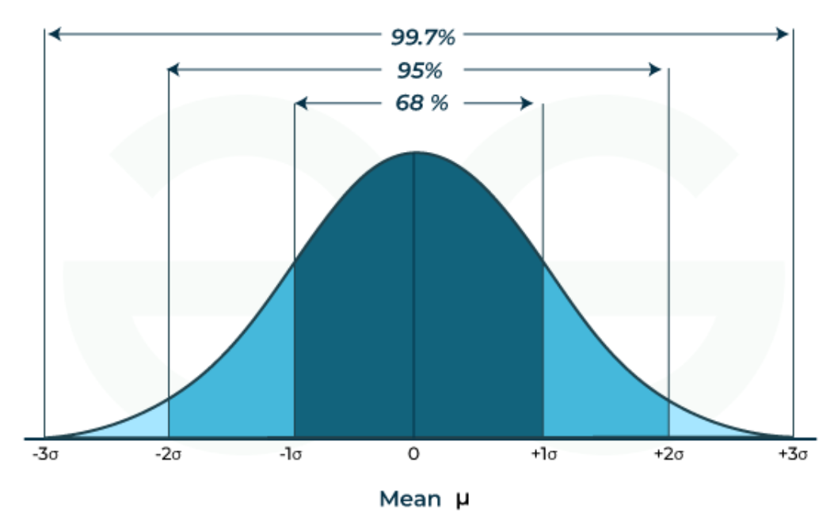
Continuous Probability Distributions
25
Note: The shape of the Normal Distribution is such that about 68% of the values fall within one standard deviation of the mean (μ ± σ), about 95% fall within two standard deviations (μ ± 2σ) and about 99.7% fall within three standard deviations (μ ± 3σ).
Figure-2: Normal Distribution (Bell Curve)

Slide 27
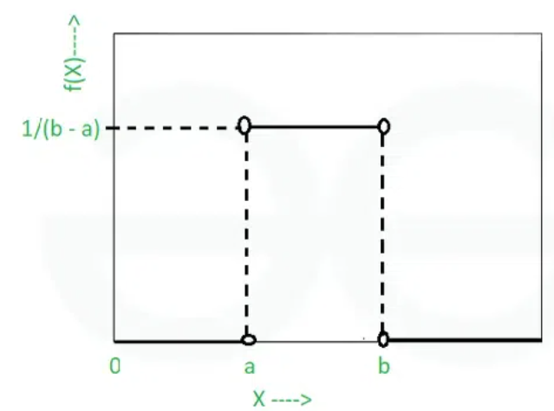


Continuous Probability Distributions
26
2. Uniform Distribution: The Uniform Distribution is a continuous probability distribution where all values within a specified range are equally likely to occur.
Parameters: Lower bound (a) and upper bound (b).
The mean of a uniform distribution is
It is expressed as:
$$μ=\frac{a+b}{2}{ and the variance is σ}^{2}=\frac{{\left(b−a)\right.}^{2}}{12}$$
Figure-3: Uniform Distribution

Slide 28
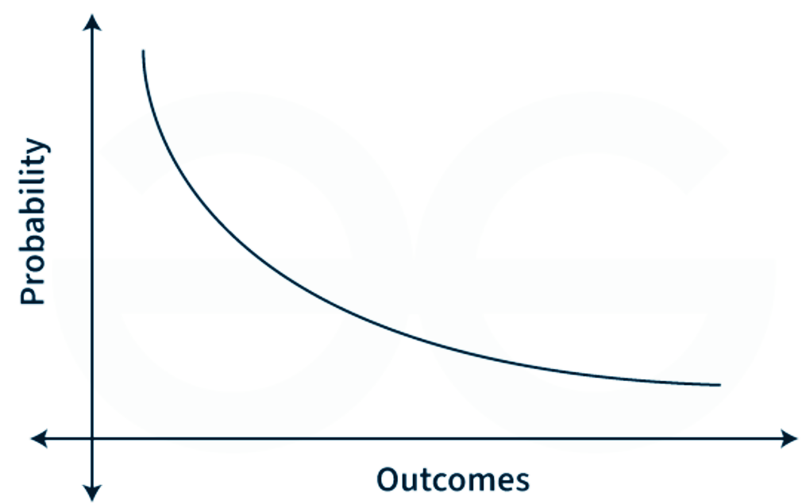

Continuous Probability Distributions
27
3. Exponential Distribution: The exponential distribution is a continuous probability distribution that represents the duration between occurrences in a Poisson process, which occurs continuously and independently at a constant average rate.
Parameter: Rate parameter (λ).
The mean of the exponential distribution is 1/λ and the variance is 1/λ²
For a random variable x, it is expressed as
Figure-4: Exponential Distribution

Slide 29
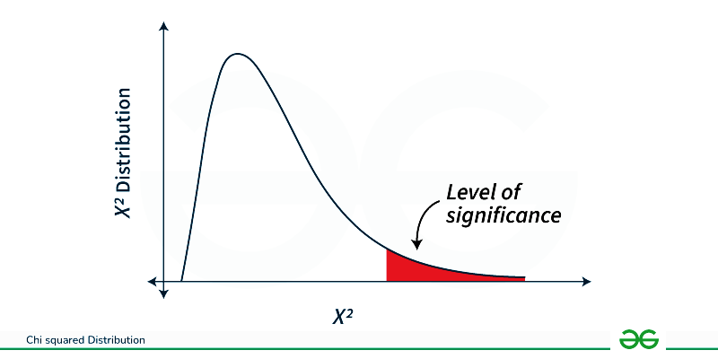

Continuous Probability Distributions
28
4. Chi-Squared Distribution: The Chi-Squared Distribution is a continuous probability distribution that arises in statistics, particularly in hypothesis testing and confidence interval estimation.
It is characterized by a single parameter, often denoted as k ,which represents the degrees of freedom.
The mean of the Chi-Squared Distribution
is k and the variance is 2k.
For a random variable x, it is expressed as
Figure-5: Chi-Squared Distribution

Slide 30
Continuous Probability Distributions
29
Discrete vs Continuous Distribution:
Discrete Distribution | Continuous Distribution
Random variable can only take on a finite or countable number of values | Random variable can take on any value within a certain range or interval
Probability function assigns probabilities to each possible outcome | Probability function assigns probabilities to each possible value within a range or interval
Examples: binomial distribution, Poisson distribution, geometric distribution | Examples: normal distribution, exponential distribution, beta distribution
Used to model events with discrete outcomes, such as number of successes in a fixed number of trials | Used to model events with continuous outcomes, such as the height of individuals in a population
Probability of any single outcome is non-zero | Probability of any single value is zero
Cumulative distribution function is stepwise | Cumulative distribution function is continuous

Slide 31
Continuous Probability Distributions
30
Applications of Continuous Probability Distribution in Computer Science
Modeling Uncertainty: They help represent uncertainty in predictions, allowing probabilistic outputs instead of fixed values.
Gaussian Distribution: Widely used in models like regression and Bayesian networks for error modeling and the assumption of normality.
MLE: Many algorithms rely on continuous distributions to estimate model parameters that maximize the likelihood of observed data.
Bayesian Inference: Continuous distributions are essential in Bayesian models to update beliefs about parameters based on new data.

Slide 32
Applications of the Topic
31
Here are applications of Discrete Distribution:
Counting number of defective items in a batch (quality control).
Number of customers arriving at a shop/bank in a fixed time (service systems).
Number of phone calls or packets arriving in a network per minute (telecom).
Number of votes / YES responses in a sample survey (elections, polls).
Number of accidents, claims or complaints in a day (insurance, safety).
Number of emails classified as spam (Bernoulli / binomial in ML).
Word counts or term frequencies in documents (text mining, Naive Bayes).
Number of retries / failures before success in a system (geometric / negative binomial).

Slide 33
Applications of the Topic
32
Here are applications of Continuous Distribution:
Modeling human measurements like height, weight, blood pressure (normal).
Measurement errors in experiments and instruments (normal).
Time to failure of machines, bulbs, components (exponential, Weibull).
Modeling stock returns and price movements (normal / log-normal).
Noise in communication channels and sensors (Gaussian).
Waiting time between arrivals of customers or calls (exponential).
Environmental values like temperature, rainfall, pollution level (continuous).
Basis for hypothesis testing, confidence intervals and regression errors (normal, t-distribution).

Slide 34
Summary of the Lecture
33
In this lecture, we discussed the discrete and continuous probability distributions are used to model uncertainty in real-world data.
Discrete distributions like Bernoulli, Binomial, Poisson, and Geometric deal with countable outcomes such as number of defects, customer arrivals, network packets, survey responses, and system failures.
Continuous distributions like Normal, Exponential, Uniform, and Gamma work with measurable values such as height, weight, temperature, noise levels, stock returns, and time to failure of machines.
Understanding these distributions helps in prediction, decision-making, statistical testing, and modeling real-life situations across domains like machine learning.

Slide 35
Next Lecture
34
In next lecture, we are going to cover:
Normal Distribution and T Distributions
RSE and R²

Slide 36
Quiz/ FAQ’s
35
Define a discrete probability distribution.
Define a continuous probability distribution.
Give two examples of discrete probability distributions.
Give two examples of continuous probability distributions.
How does a discrete distribution differ from a continuous distribution?
Name one real-life situation modeled using a Poisson distribution.
Name one real-life situation modeled using a Normal distribution.
What type of data is used in binomial distribution?
Which distribution is suitable for modeling waiting time or time to failure?

Slide 37
References/ Articles/ Videos
36
Text/ Reference Books
T1 | Massaron, L., & Boschetti, A. (2016). Regression analysis with Python. Packt Publishing Ltd.
T2 | Jajuga, K., Sokolowski, A., & Bock, H. H. (Eds.). (2012). Classification, clustering, and data analysis: recent advances and applications.
T3 | Bishop, C. M., & Bishop, H. (2023). Deep learning: Foundations and concepts. Springer Nature.
R1 | Matloff, N. (2017). Statistical regression and classification: from linear models to machine learning. Chapman and Hall/CRC.
R2 | Jajuga, K., Sokolowski, A., & Bock, H. H. (Eds.). (2012). Classification, clustering, and data analysis: recent advances and applications.
R3 | Vishnoi, V. K., Chauhan, N. R., & Kumar, K. (2024). An introduction to deep learning. Xoffencerpublication.

Slide 38
Faculty-curated videos, NPTEL, Coursera, LinkedIn, or other relevant learning resources
37
https://youtu.be/Qm9ynLpyIIw
https://youtu.be/QxqxdQ_g2uw
https://www.coursera.org/learn/ai-for-real-world-intelligence-systems?source=admin-share
https://www.coursera.org/learn/ai-for-real-world-intelligence-systems?source=admin-share
https://www.coursera.org/learn/deep-learning-applications-in-vision?source=admin-share
https://www.coursera.org/learn/deep-learning-applications-in-vision?source=admin-share
https://www.coursera.org/learn/ismdl?source=admin-share
https://youtu.be/xFss2H1Cq5w

Slide 39

38
Class-Wise Feedback
Note: Scan this QR code to provide anonymous feedback.

Slide 40
39
Thank You
For queries
Email: siddharth.e12853@cumail.in

